Slide 1

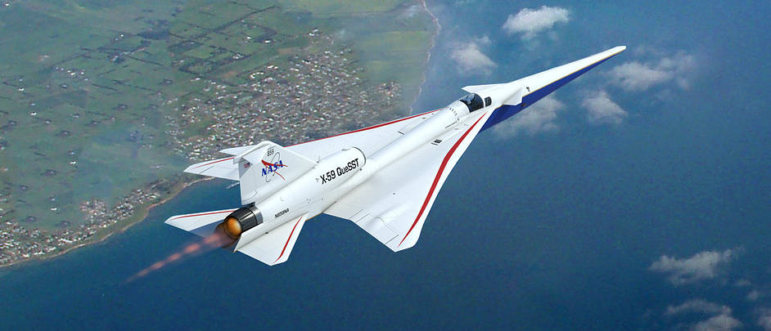
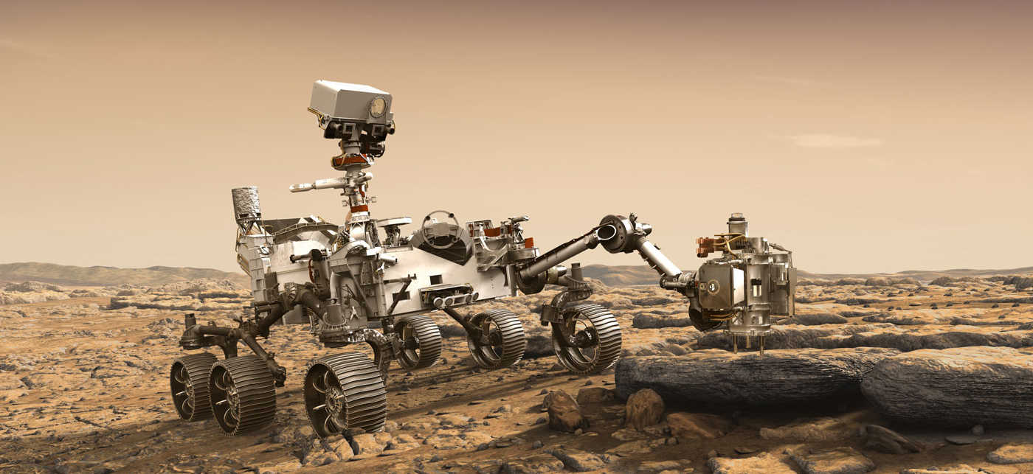
NASA Langley Research Center
Transformation
Construction on 170,000-SF Measurement Systems Lab is nearing completion. Plans for Flight Dynamics Research Facility are progressing.
Advanced Air Mobility
Langley plays a leading role in developing technologies and concepts for trusted autonomy and vehicle contingency management — paving the way for future advanced air mobility.
Earth Science
CLARREO Pathfinder, recommended by the 2017 Decadal Survey, is due to be installed on the International Space Station in 2023. Langley selected Intelsat and Maxar Technologies to host NASA’s Tempo instrument which will launch on a SpaceX Falcon 9 in 2022.
Artemis Program
Langley, a key player in NASA’s Human Landing System effort, collaborates with Blue Origin, SpaceX, and Dynetics. Langley’s Navigation Doppler Lidar was demonstrated on a suborbital flight test this fall.
Human Space Flight
Langley’s SCIFLI team supported the first crewed launch from U.S. soil since 2011 to the Space Station. Langley continues to support Commercial Crew and Orion testing and development. Orion Structural Crew Module Test Article drop tests scheduled to begin in January 2021.
NASA’s X-59 Quiet SuperSonic Technology aircraft is being assembled at Lockheed Martin Skunk Works® in California. The X-plane’s mission is to help open a new era of commercial supersonic travel over land.
Don’t miss the Mars 2020 Perseverance Rover landing on Mars February 18, 2021. Langley has made significant contributions to Mars 2020, including entry, descent and landing, testing of the parachute, helicopter and heatshield, and leading the MEDLI2 Project for future landings on Mars.
Notes:
Advances at Langley will lead to faster aircraft and more capable drones. New technologies could save lives, protect the environment and boost the economy.
Langley scientists defend life on our home planet through a better understanding Earth's climate, weather, atmosphere and air quality.
As NASA embarks on human exploration of deep space, Langley contributions will drive mission success, protect America’s space pioneers and help make history

Slide 2
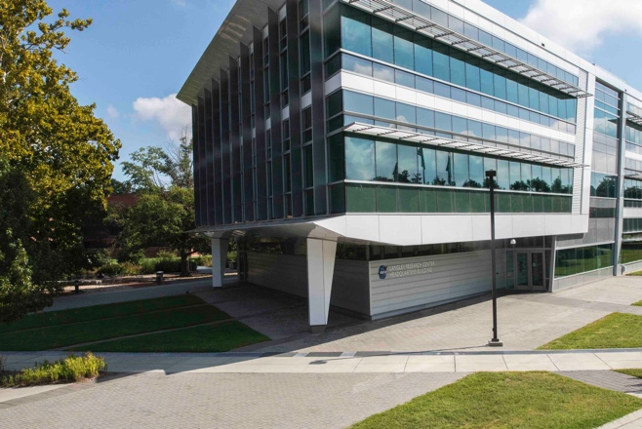

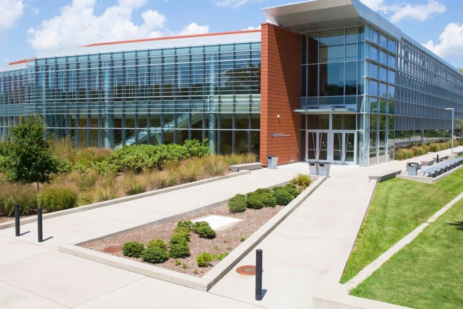

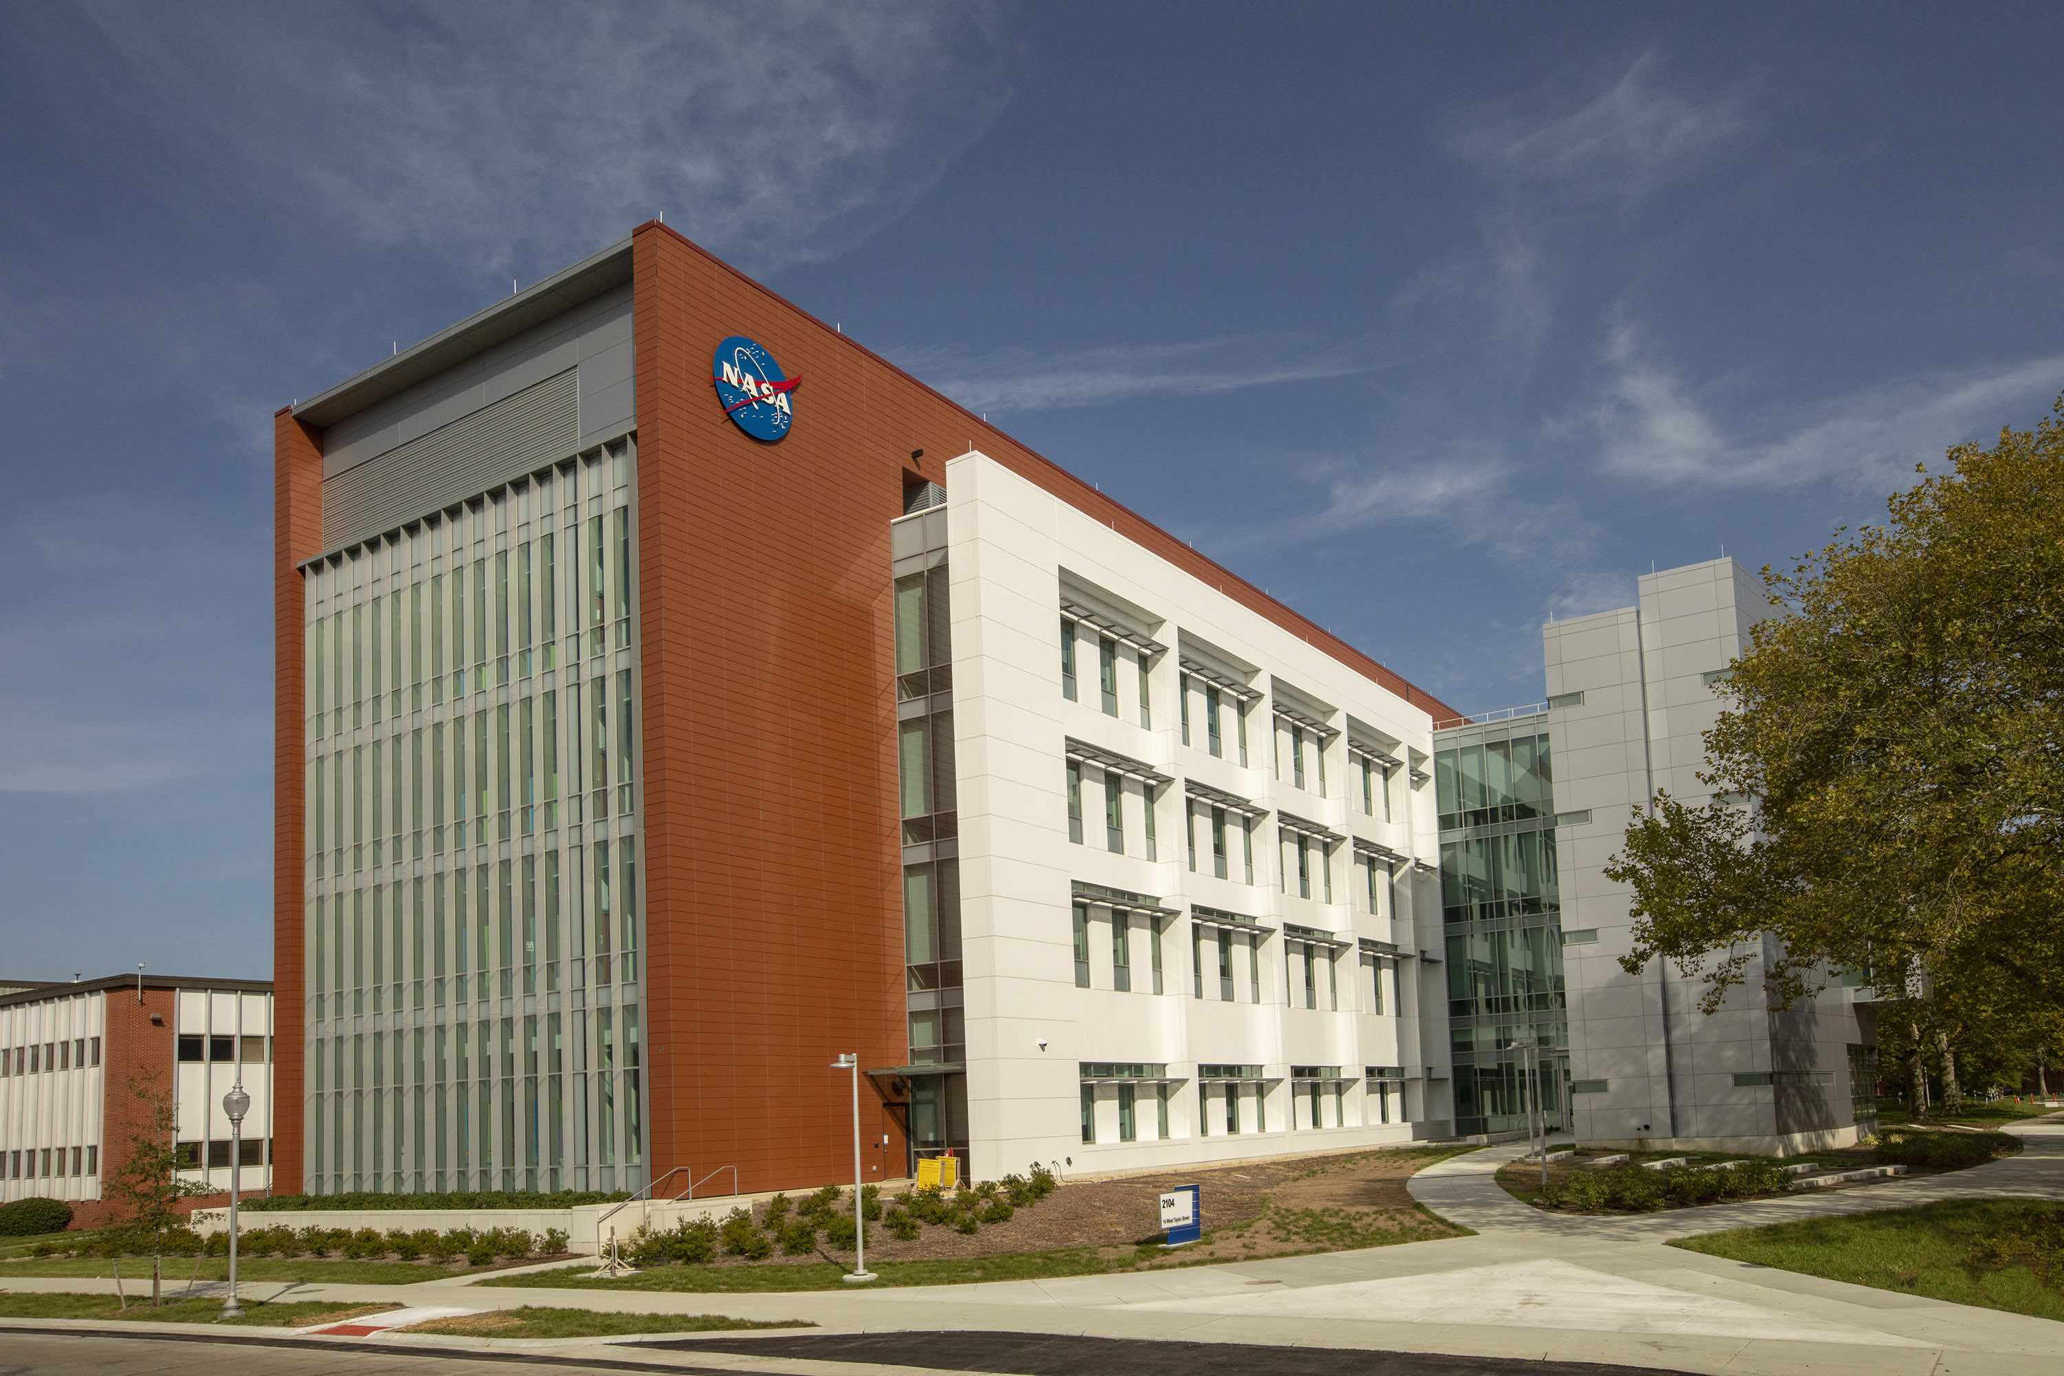
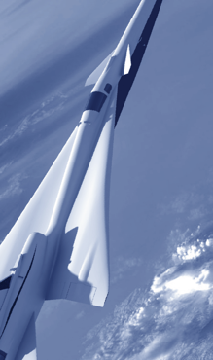
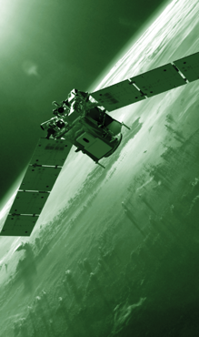
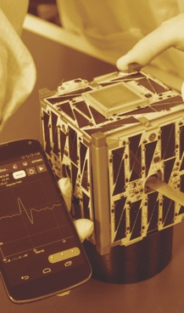
NASA Langley Research Center
ECONOMIC IMPACT*
National
Virginia
Hampton Roads
Workforce / Infrastructure
$2.3 Billion
$1.1 Billion
$902 Million
~1,800
~1,700
17,930
Jobs
8,832
Jobs
8,347
Jobs
* Numbers above are based on fiscal 2019, Langley spent about $368 million in Virginia with 58 percent of that going to small businesses.
Civil servants
Contractors on/near site
FY 2021 budget: $864 million Includes $15 million in external business
$110 million
$208 million
$237 million
$294 million
189 buildings, 764 acres
Infrastructure/Facilities value: $3.9 billion
Space Exploration
Aeronautics
Earth Science
Transformation
Data as of 12/31/20
Notes:
Innovation at Langley protects lives, encourages efficient use of tax dollars and has potential to inspire improvements across the federal government
Langley has a significant economic contributions, collaborations and tech transfer activities have a significant impact on the nation, the Commonwealth and the region.
Langley is leaning forward in the virtual world with new online content for educators, participating in outreach events, virtual launch viewings and new resources for those without Internet, like our partnership with PBS Richmond.

Slide 3
Back Up

Slide 4
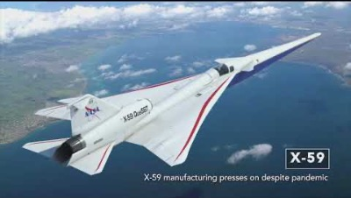
NASA Langley Recent Milestones
Notes:
NASA Langley 2020 Accomplishments: A Year of Perseverance.
https://youtu.be/V1BUm3fnk4c

